Slide 1




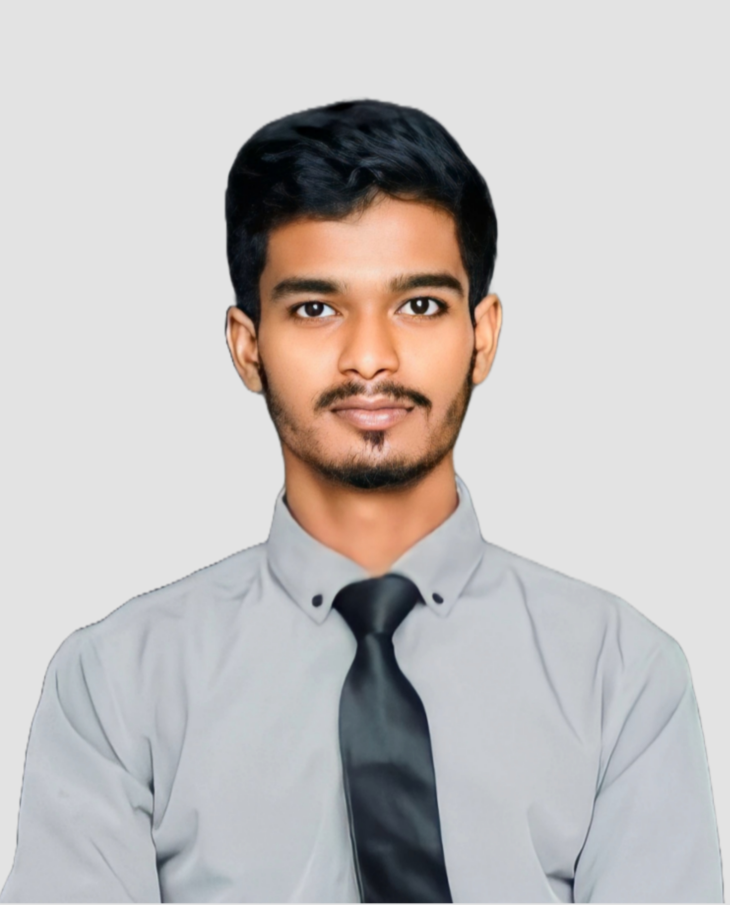
MD. Shoaib Sikder
Software Engineer
01777936837
sikder2305341157@diu.edu.bd
shoaibsikder.github.io/My-Portfolio
EDUCATION
ABOUT ME
Daffodil International University
I’m MD. Shoaib Sikder, a dedicated software engineering student with a passion for developing innovative solutions. I am currently pursuing my degree in Software Engineering at [DIU], where I have gained hands-on experience in software development, algorithms, and system design. I enjoy participating in hackathons, contributing to open-source projects, and staying updated with the latest advancements in technology.
BSc. In Software Engineering
2023 - Current
Bangladesh Gas field school &
collage
Higher Secondary Certificate (HSC)
PROJECT EXPERIENCE
2019 - 2021
Web Development Project
Shohagpur Achiya Safiuddin Adarsha Madhyamik School
Secondary School Certificate (SSC)
Porfolio : Designed and Developed a responsive portfolio using HTML, CSS and javaScript. Project Link : https://github.com/ShoaibSikder/My-Portfolio
Note Sharing System: Developed a Student note sharing system using HTML ,CSS, javaScript and php. Where every student can share their notes. Project Link: https://github.com/ShoaibSikder/Note-Sharing-System
2014 - 2019
SKILLS
C
App Development Project
Java
Health Monitoring System: Made a health monitoring using C programing where user input their health data and the system tell them their problem and prescribe some medicine. Project Link: https://github.com/ShoaibSikder/Health-Monitoring-System-Project
Employee Record System: Made this using Java. this helps to store all employs details and manage them. Project Link: https://github.com/ShoaibSikder/Employee-Record-System
HTML
CSS
javaScript
php
Programming Practice
I practice my programming skill on various platform (Beecrowd, LeetCode, CodeFOrce). And participated on many programming contests.
LANGUAGE
REFERENCES
Bangla
Mr. Fahim Faisal
Mr. Z N M Zarif Mahmud
English
Lecturer (DIU)
Lecturer (DIU)
Hindi
Phone:
01778527920
Phone:
01740087267
Email :
faisal.cse505.c@diu.edu.bd
Email :
zarif.cse0538.c@diu.edu.bd

